Slide 1
Bank : customer churn analysis
Abhishek Sharma

Slide 2
CONTENTS
Introduction
Primary goal
Database
Implementation and methods used
Summary

Slide 3
INTRODUCTION
A certain bank in North America want to perform customer churn analysis, as the credit card business of bank is not performing very well. Churn Analysis will help the bank evaluate the customers who have stopped purchasing credit cards of bank and figure out measure to reduce the bank’s customer loss rate.

Slide 4
Primary goal
Analyze the Customer data of North America bank and build and interactive dashboard using Tableau.

Slide 5
database
CLIENTNUM
Attrition_Flag
Customer_Age
Gender
Dependent_count
Client number. Unique identifier for the customer holding the
account.
Internal event (customer activity) variable. If the account is
closed, then it is 1, otherwise it is 0.
Demographic variable - Customer's age in years
Demographic variable - M=Male, F=Female
Demographic variable - Number of dependents

Slide 6
database
Education_Level
Marital_Status
Income_Category
Card_Category
Region
Demographic variable - Educational qualification of the
account holder (example: high school, college graduate, etc.)
Demographic variable - Married, Single, Divorced, Unknown
Demographic variable - Annual income category of the
account holder (< $40K, $40K - 60K, $60K - $80K, $80K-$120K, > $120K,
Unknown)
Product Variable - Type of card (Blue, Silver, Gold, Platinum)
The region to which the account holder belongs

Slide 7
database
Months_on_book
Total_Relationship_count
Months_Inactive_12_mon
Contacts_Count_12_mon
Credit_Limit
The period since the loan is purchased
Years of relationship with the bank
Months of inactivity in the last 12 months
Contact made by bank in the last 12 months
Credit limit offered by the bank on the card

Slide 8
database
Total_Revolving_Bal
Avg_Open_to_Buy
Total_Trans_Amt
Total_Trans_Ct
Average_Utilzation_Ratio
Balance that carries over month to month
Difference between the credit limit assigned to a card
holder and the present balance on the account
The total amount transacted by the customer
The total number of transactions by the card holder(Last 12
months)
Utilization of card and calculated average

Slide 9




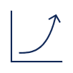
Data pre-processing
Step 1
Step 2
Step 3
Step 4
Step 5
Load csv file into DataFrame
Fill missing values with mode and mean respectively
Describing data by checking –
Mean
Median
Mode
Min
Max
Shape
Info
Std etc.
Check if any outlier will affect analysis
Export the updated DataFrame to csv file

Slide 10



Creating figma template
Step 1
Step 2
Step 3
Step 4
Step 5
Login to Figma.com
Create a new blank template
Drag and drop various shapes as per your need in the template and align them
Format the shapes and colors inside template in well organized way .
Download the template and use it in creating interactive Dashboard

Slide 11
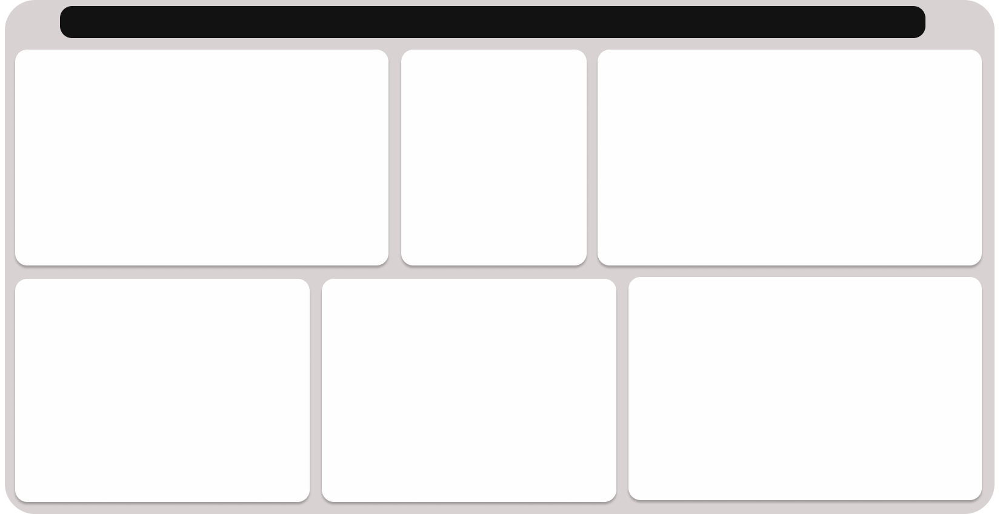
Overview of figma template

Slide 12
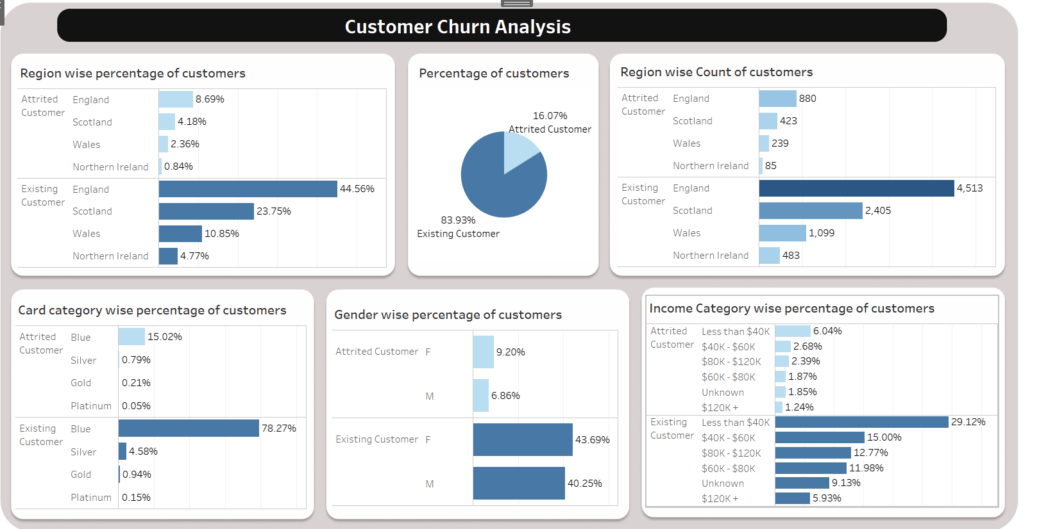

Dashboard - 1

Slide 13
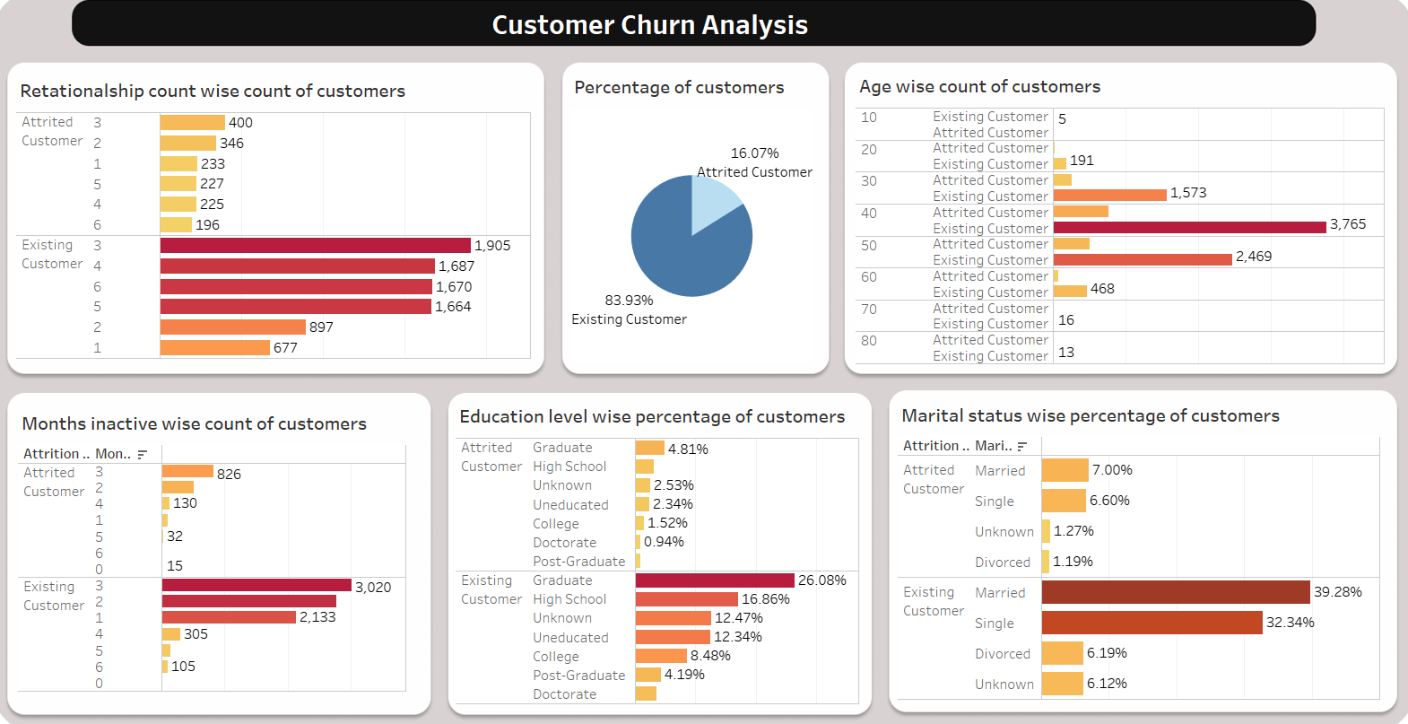
Dashboard - 2

Slide 14
Filters in dashboards
Dashboard -1
Dashboard -2
This Dashboard has 2 filters.
The visuals with star sign on them contains filter
Every other visual will respond if you click on either of 2 visuals (containing filters)
This Dashboard has 6 filters.
Every single visual contains filter
Every visual will respond if you click in any of visual.

Slide 15
SUMMARY
Now the North America bank can use these two dashboard to figure out more about the customers who are leaving bank and take actions accordingly.
They can use dashboard to know about any details of the customers, The dashboard will respond with respective visual each time you click on any field in visuals

Slide 16
THANK YOU
Abhishek Sharma
as826385@gmail.com

